Slide 1

SERVICE ANIMALS IN NYS PUBLIC HOUSING
the ADA, NYS HRL & the FHA

Slide 2
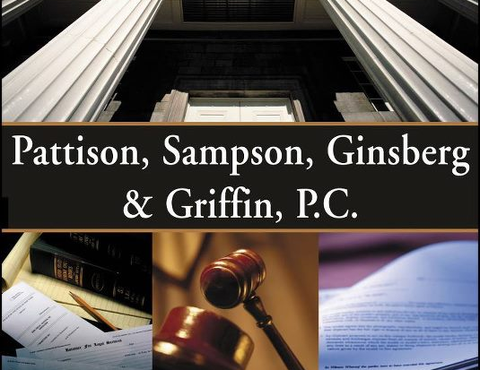
Michael E. Ginsberg, Esq.
Managing Partner
Firm practices extensively in the areas of Public Housing, Landlord/Tenant matters, and Evictions.

Slide 3

What is a Service Animal?
Service animals are defined as dogs that are individually trained to do work or perform tasks for people with disabilities.
Service animals are working animals, not pets. The work or task a dog has been trained to provide must be directly related to the person’s disability. Dogs whose sole function is to provide comfort or emotional support do not qualify as service animals under the ADA.

Slide 4

The American with Disabilities Act
Title III - PUBLIC ACCOMMODATIONS AND SERVICES OPERATED BY PRIVATE ENTITIES.
Anti-Discrimination.
No individual shall be discriminated against on the basis of disability in the full and equal enjoyment of the goods, services, facilities, privileges, advantages, or accommodations of any place of public accommodation.
A public housing residential unit is a place of lodging and considered to be a place of public accommodation.
Cannot deny the opportunity to participate in or benefit from the goods, services, facilities, privileges, advantages, or accommodations of the public housing entity – with or without reasonable accommodation.
Signed into law on July 26, 1990, by President George H.W. Bush.
Modeled after the Civil Rights Act of 1964 (prohibits discrimination on the basis of race, color, religion, sex, or national origin) and Section 504 of the Rehabilitation Act of 1973.
Purpose - To provide a clear and comprehensive national mandate for the elimination of discrimination against individuals with disabilities.

Slide 5

SERVICE Animals in public housing
SERVICE ANIMALS IN PUBLIC HOUSING
ADA Title II §35.136 Service Animals / Title III §36.302(c): Service Animals.
General. Generally, a public entity shall modify its policies, practices, or procedures to permit the use of a service animal by an individual with a disability.
Exceptions. A public entity [accommodation] may ask an individual with a disability to remove a service animal from the premises if—
(1) The animal is out of control and the animal’s handler does not take effective action to control it.
Animal must be on a harness, leash, or other tether unless it would interfere with the animal’s service performance and the animal is otherwise under the handler’s control.

Slide 6


SERVICE Animals in public housing (Cont.)
Federal regulations provide that a housing provider can only invoke the direct threat exception after conducting an individualized and objective assessment of the relevant factors, including (1) the nature, duration, and severity of the risk; (2) the probability that the potential injury will actually occur; and (3) whether any reasonable accommodations will mitigate the risk (24 CFR 9.131 [c])
The animal can be excluded where it poses a direct threat and its owner takes no effective action to control the animal's behavior so that the threat is mitigated or eliminated.
Or if the animal is not housebroken.
(e) The public entity is not responsible for the care or supervision of a service animal.
(f) Inquiries. A public entity may not ask about the nature or extent of a person’s disability.
It can inquire-
whether an animal qualifies as a service animal.
(2) if the animal is required because of a disability. and
what work or task the animal has been trained to perform.
They are not permitted to request documentation for the dog or require the dog to demonstrate a task.
(g) Access to areas of a public accommodation. Individuals with disabilities shall be permitted to be accompanied by their service animals in all areas of a public entity’s accommodation.
(c) If an animal is properly excluded under subsection (b) the individual with a disability must be given the opportunity to participate in the program without the animal.
.

Slide 7

Comfort Animals
THE DIFFERENCE BETWEEN SERVICE ANIMALS AND COMFORT ANIMALS
Under The ADA and NYS Law, a service animal is defined as a dog that is individually trained to do work or perform tasks for the benefit of an individual with a disability.
Including physical, sensory, psychiatric, intellectual, or other mental disabilities.
The tasks performed by the service animal must be directly related to the individual's disability.
such as guiding individuals with impaired vision, alerting individuals with impaired hearing, pulling a wheelchair, or assisting during a seizure.
Emotional support or comfort provided by the animal does not qualify as a task under the ADA.
Comfort Animals are not trained to perform specific tasks related to a disability.

Slide 8

NY Human Rights Law and the FHA The ADA may exclude emotional support animals from its definition of service animals; however the NYS Human Rights Law and the FHA recognize them as a valid form of reasonable accommodation in housing.
Under the NYS Human Rights Law (Executive Law Art 15) a tenant may keep an emotional support animal if they demonstrate that
they are disabled, and
qualify for the tenancy, and
because of their disability it is necessary for them to keep the dog in order for them to use and enjoy the apartment, and
that reasonable accommodations could be made to allow them to keep the dog (see Executive Law § 296 [2] [a].)
Provided the animal assists with a disability, and
The animal does not pose undue hardship or direct threats.
Such distinction reflects the different purposes of the two laws. (1) The ADA focuses on public access and accommodation.
The FHA focuses on equal housing opportunities for individuals with disabilities.

Slide 9
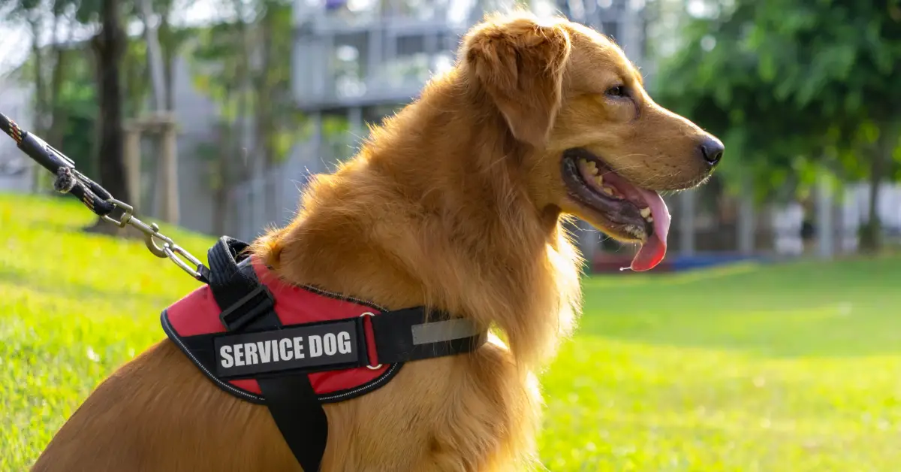



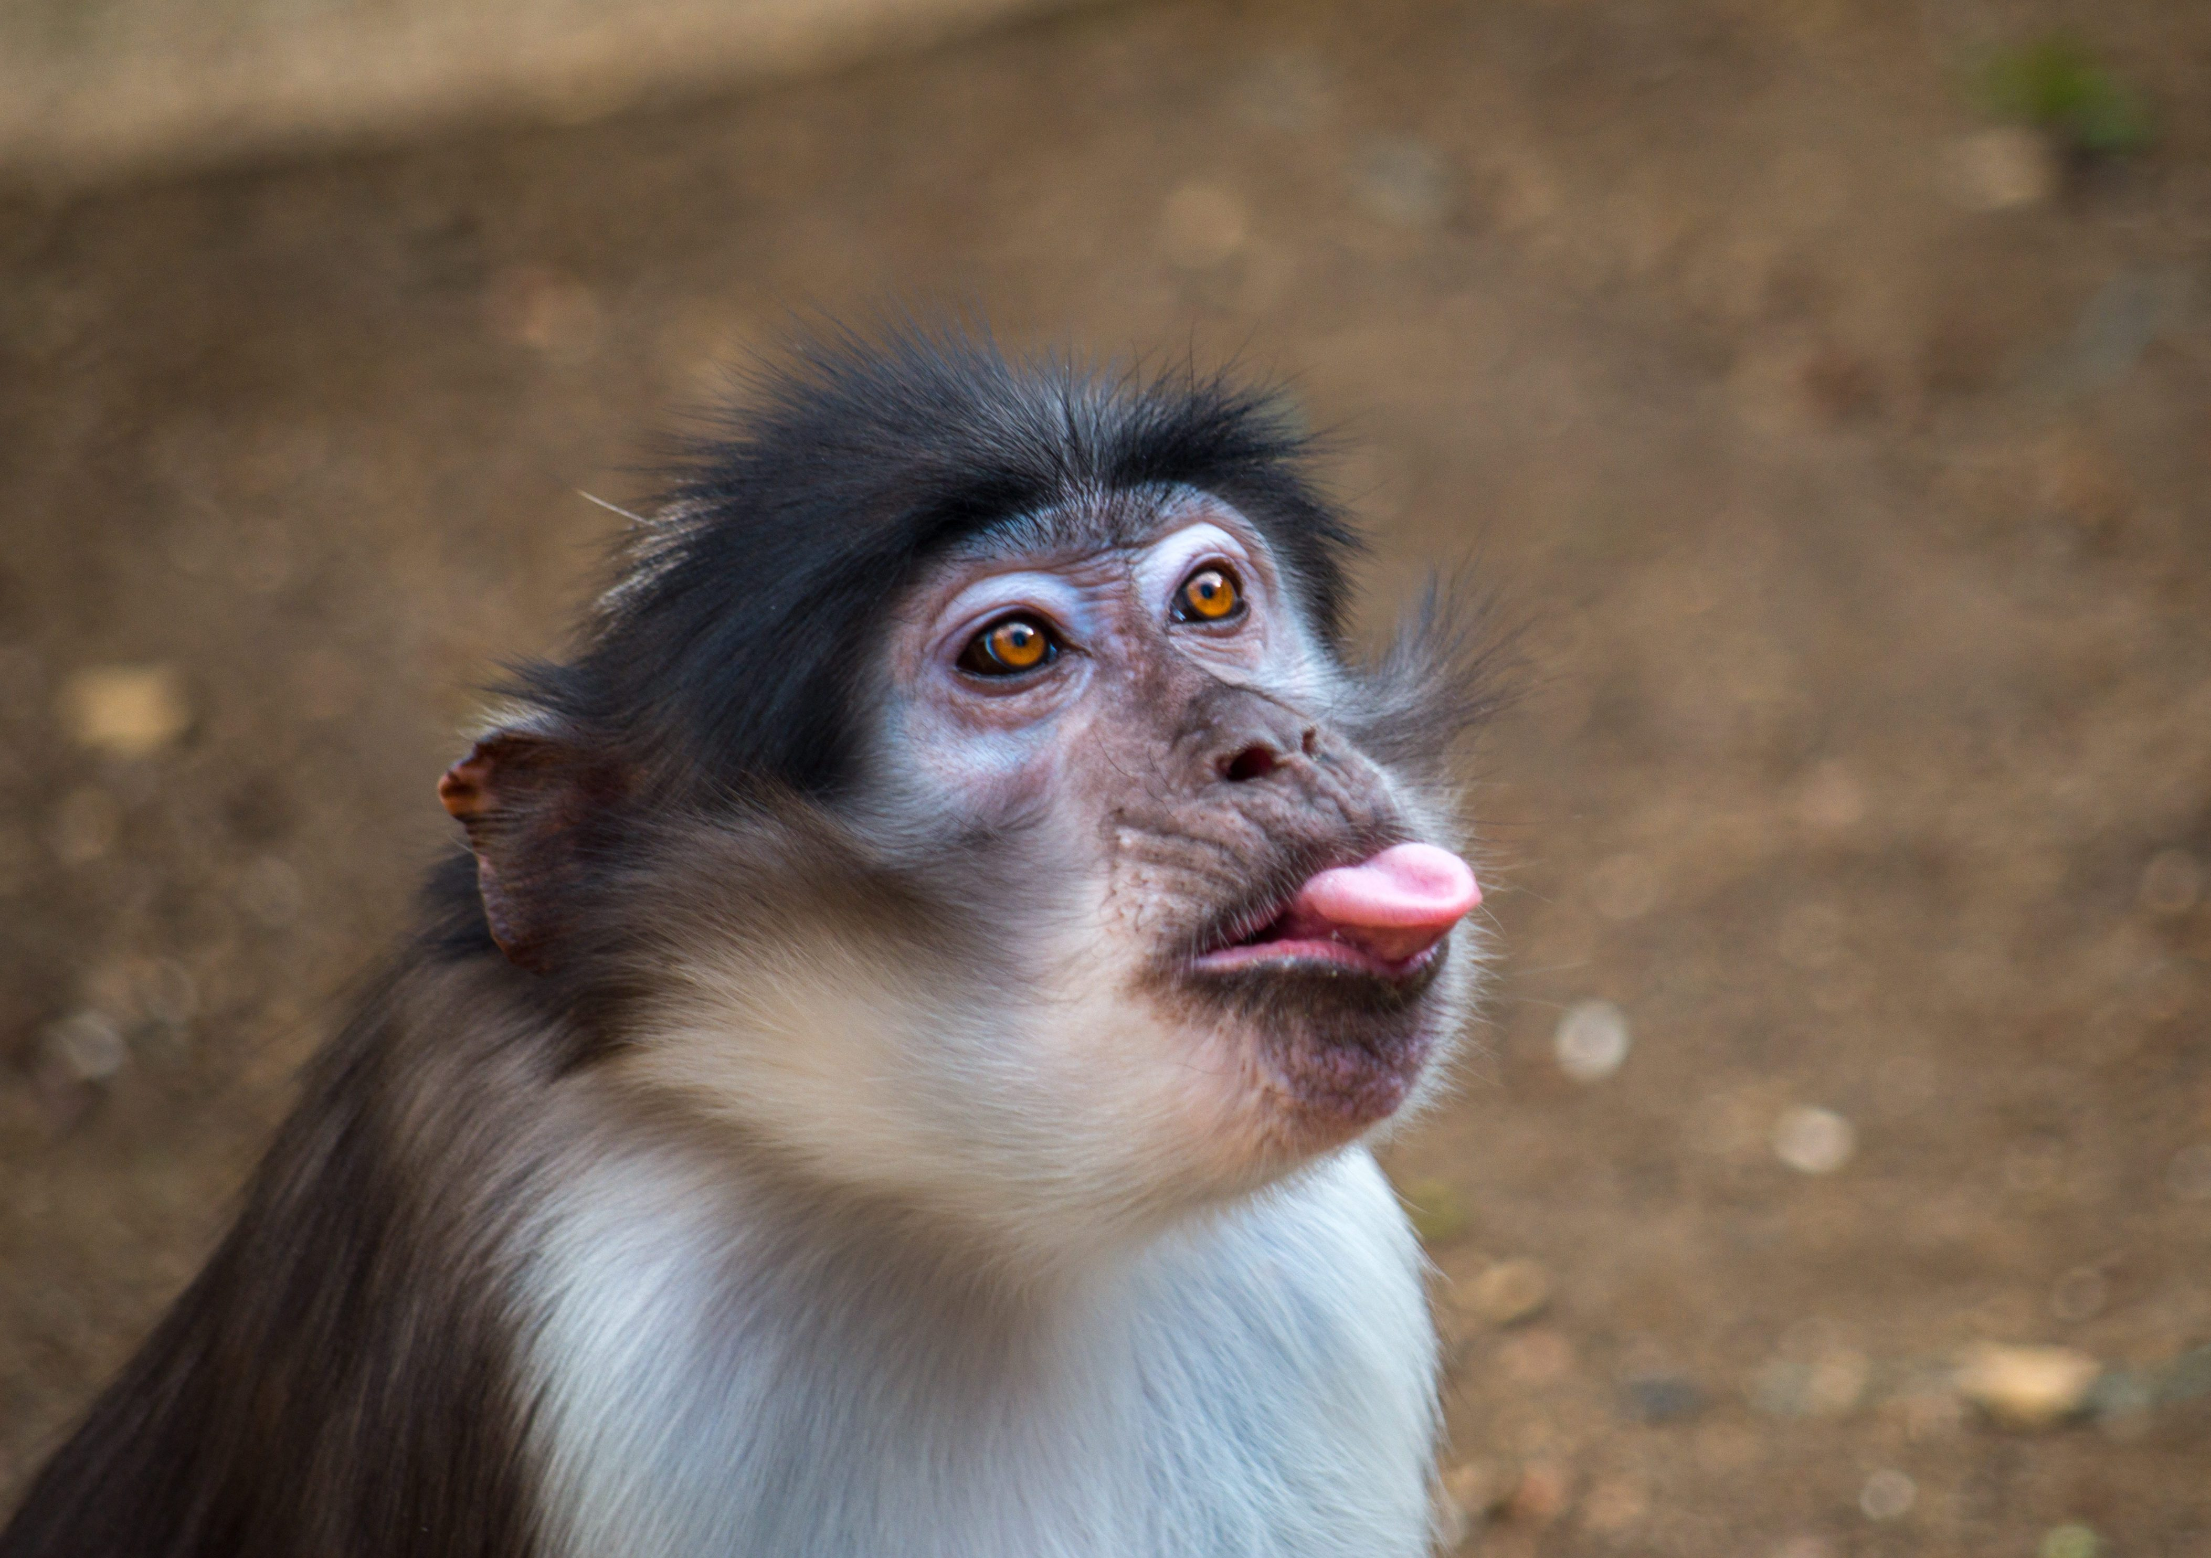
PERMITTED ANIMALS
Under The ADA
Service dogs
Mini horses
The regulation explicitly excludes wild animals, including monkeys and other nonhuman primates, from being classified as service animals . 28 CFR 36.104.

Slide 10



Under NYS Law and the FHA
Birds – as long as they meet the criteria for emotional support animals they are permitted
Primates - New York law prohibits the possession of wild animals, including chimpanzees and monkeys, as pets, NY CLS Penal § 242.00; NY CLS ECL § 11-0512. Therefore, chimpanzees and monkeys cannot generally be kept as emotional support animals in New York.
Reptiles - New York law, distinguishes between "wild animals" and "domestic animals," and reptiles capable of inflicting bodily harm are classified as wild animals.
Such does not necessarily preclude reptiles from being emotional support animals but may impose additional considerations regarding public safety.
Animals commonly kept in households - dog, cat, small bird, rabbit, hamster, gerbil, other rodent, fish, turtle, or other small, domesticated animal.
Per HUD requirements, if the animal is of this type, the landlord should grant the accommodation.

Slide 11
Under NYS Law and the FHA (cont.)
Considerations in determining whether an animal is acceptable for emotional support.
Is the animal a “reasonable accommodation” for the tenant’s disability? Does it alleviate the tenant’s condition.
Requires adequate medical documentation.
Does the animal allow the tenant to use and enjoy the dwelling.
Does use of the animal pose a direct threat to people.
How to comply with the law.
First, apply the ADA service animal definition.
If the animal meets the requirements, it should be approved.
If the animal does not meet the ADA requirements, apply the NYS and FHA definitions for emotional support animals.
If it meets those requirements, it should be approved.
Under the test, the animal must be (1) necessary to alleviate the effects of the disability (2) doesn’t pose an undue hardship or substantial burden on the landlord, (3) doesn’t pose a significant risk of damage to person or property. Matter of Washington v Olatoye, 173 A.D.3d 467 (2019)

Slide 12

Case STUDY
Lesser vs. Rutherford Coop. (Aug. 2024)
In 2016 eviction proceedings were brought against a tenant in NYC for having three parrots in her unit.
Other tenants had made numerous complaints about noise for years.
The tenant asserted that the parrots were emotional support animals and provided medical documentation.
After denial by the Coop, she filed a complaint with HUD and the DOJ filed suit against the Coop.
In August 2024 the case settled, and the tenant received $165K. The Coop was also required to adopt a reasonable accommodation policy.

Slide 13


Thank you

